Slide 1
Introduction to P - NP - NP Hard and NP Complete
Classes of Complexity and Approximation
Algorithms

Slide 2
Introduction to P and NP
P = { Problems solvable in Polynomial time }
- deterministic ? Non-Deterministic ?
Size of the problem = n
Polynomial time may be O(1), O(logn) or O(nlogn) so on
Eg. Polynomial time Problems
Linear Search –n
Binary Search – logn
Insertin sort n²
Merge Sort- nlogn

Slide 3
NP= { Decision Problems solvable in Non-
deterministic Polynomial time }
Decision – gives YES or NO as Answer
Non-deterministic –Guess one out of polynomially many options in O(1) times
If any guess leads to YES then get such a Guess
If NO – Absolutely No path would lead to YES
Example
0/1 Knapsack - 2^{n}
TSP- 2^{n}
Graph Coloring- 2^{n}
Sum of Subset- 2^{n}

Slide 4
NP HARD and NP COMPLETE
POLYNOMIAL TIME | EXPONENTIAL TIME
Linear search - n | 0/1 Knapsack - 2^{n}
Binary search - log n | TSP - 2^{n}
Insertion sort - n² | Sum of Subset - 2^{n}
Merge sort - nlogn | Graph Coloring - 2^{n}
Matrix multiplication - n³ | Hamiltonian Cycle - 2^{n}

Slide 5
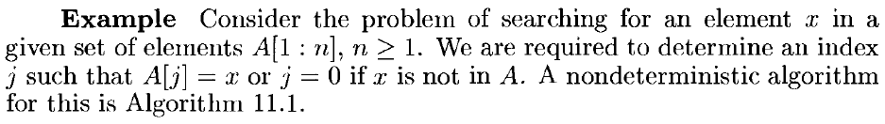
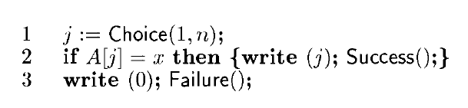
NON DETERMINISTIC ALGORITHMS
The result of every operation is uniquely defined is known as deterministic algorithms
Allowing algorithms whose outcomes are not uniquely defined but the limit to specify set of possibilities
Such algorithms is allowed to choose any one of these outcomes subject to a termination condition to be defined later. This leads to the concept called non deterministic algorithms.
To specify such algorithms, we need to specify 3 functions
Choice (s) – Arbitrarily chooses one of the elements of set S
Failure () – Signals Unsuccessful completion
Success() – Signals a Successful completion
Non-deterministic Search

Slide 6
Non Deterministic Algorithm
Algorithm Nsearch(A,n,key)
{
j = choice();
if (key=A[j])
{
write (j);
success();
}
write(0);
Failure();
}

Slide 7
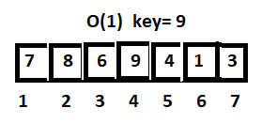
Non Deterministic Algorithm
Algorithm Nsearch(A,n,key)
{
j = choice(); _________1
if (key=A[j])
{
write (j);
success(); ______________1
}
write(0);
Failure();__________________1
}
------
O(1)

Slide 8
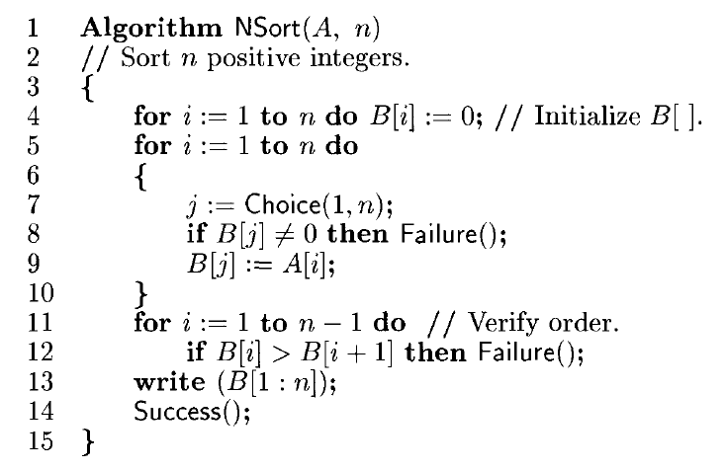
Non deterministic Sorting Algorithm

Slide 9
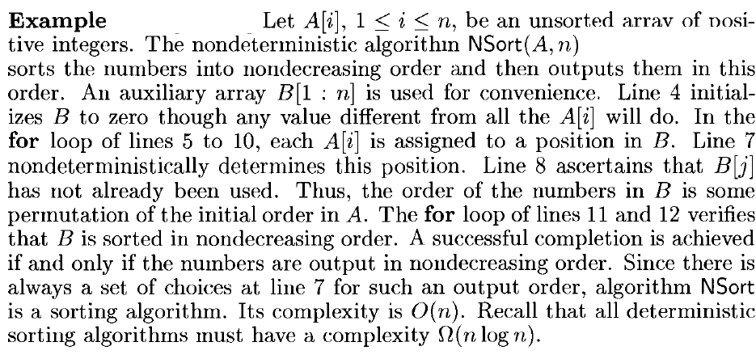

Slide 10
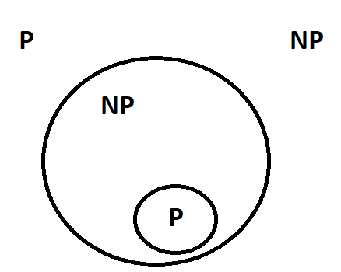

Slide 11
CNF Satisfiability
A Boolean formula is said to be in Conjunctive Normal Form or CNF, if it is expressed as an AND of Clauses.
A clause is the OR of literals
A literal is a variable or its negation
A CNF is said to be in 3CNF if each clause has exactly three different literals. For example
consider the Boolean expression
Φ1 Ξ( x1 V ¬ x2) Λ ( x2 V x3 ) Λ (¬x1 V ¬x3)
Φ2 Ξ( x1 V x2 V x3) Λ (¬ x2 V ¬ x3 V x4 ) Λ (¬ x1 V x3 V x4 )
it is clear that Φ1 is in 2 CNF and Φ2 is in 3 CNF

Slide 12
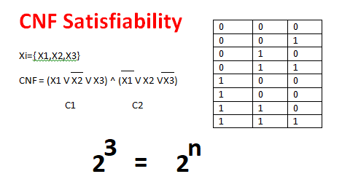

Slide 13
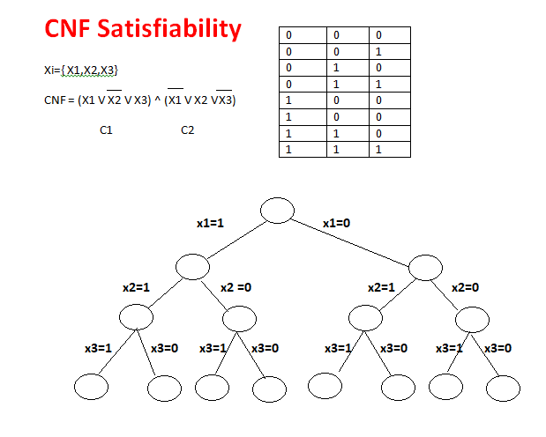

Slide 14
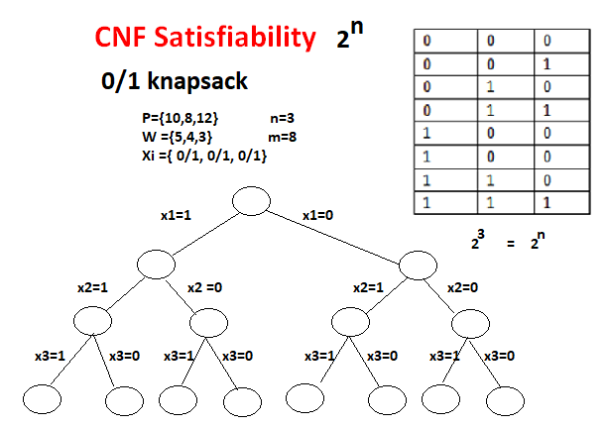

Slide 15
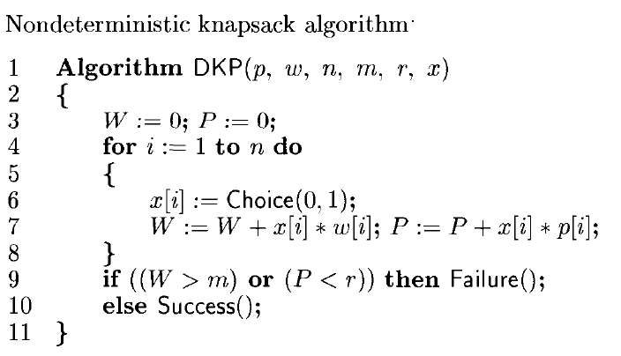

Slide 16
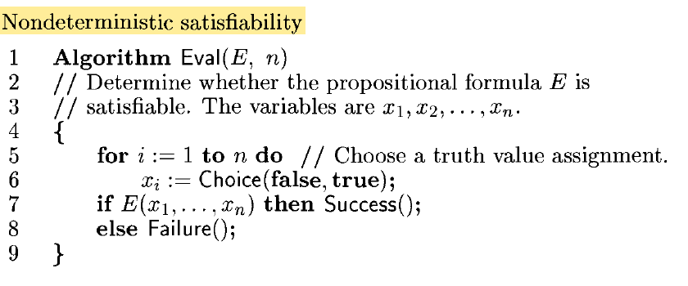

Slide 17
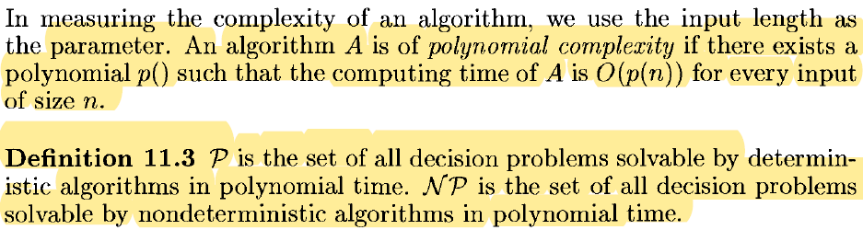
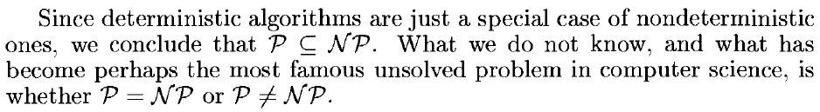
NP HARD and NP COMPLETE

Slide 18
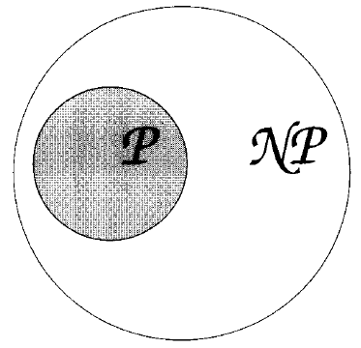
Relationship with P and NP
Cooks Theorem
Satisfiability is in P if and only if P=NP

Slide 19
NP-hard
What does NP-hard mean?
– A lot of times you can solve a problem by reducing it to a different problem. I can reduce Problem B to Problem A if, given a solution to Problem A, I can easily construct a solution to Problem B. (In this case, "easily" means "in polynomial time.“).
A problem is NP-hard if all problems in NP are polynomial time reducible to it, ...
Ex:- Hamiltonian Cycle
Every problem in NP is reducible to HC in polynomial time. Ex:- TSP is reducible to
HC.
B
A
Example: lcm(m, n) = m * n / gcd(m, n),
13

Slide 20
NP-complete problems
A problem is NP-complete if the problem is both
NP-hard, and
NP.

Slide 21
Reduction
A problem R can be reduced to another problem Q if any instance of R can be rephrased to an instance of Q, the solution to which provides a solution to the instance of R
– This rephrasing is called a transformation
Intuitively: If R reduces in polynomial time to Q, R is “no harder to solve” than Q
Example: lcm(m, n) = m * n / gcd(m, n),
lcm(m,n) problem is reduced to gcd(m, n) problem

Slide 22
NP-Hard and NP-Complete
If R is polynomial-time reducible to Q, we denote this R <=_{p} Q
Definition of NP-Hard and NP- Complete:
If all problems R  NP are polynomial-time
reducible to Q, then Q is NP-Hard
We say Q is NP-Complete if Q is NP-Hard and Q belongs to NP
If R <=_{p} Q and R is NP-Hard, Q is also NP-Hard

Slide 23
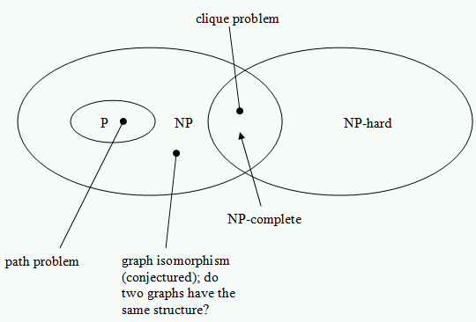

Slide 25
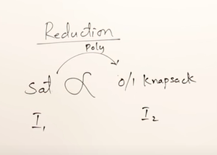
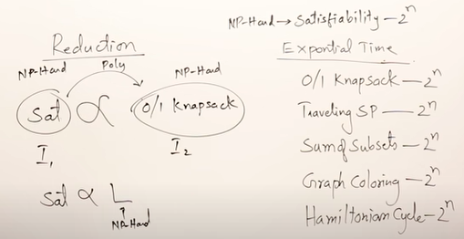

Slide 26
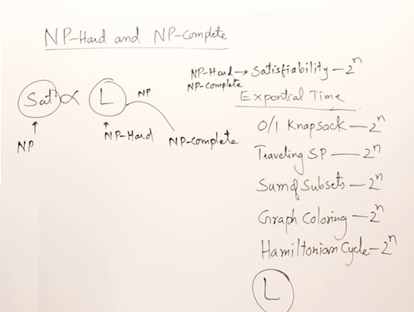

Slide 27
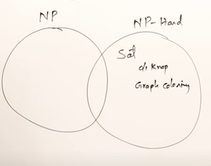
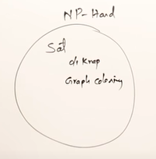
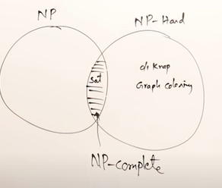

Slide 28
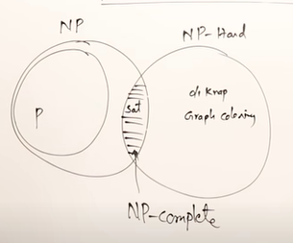

Slide 29
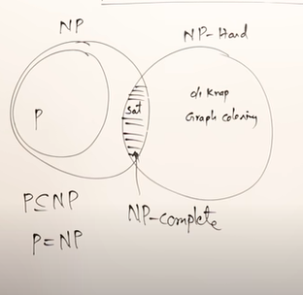

Slide 30
